Slide 1
CS162 Operating Systems and Systems Programming Lecture 27 Distributed File Systems Quantum Computing
May 2nd, 2023
Prof. John Kubiatowicz
http://cs162.eecs.Berkeley.edu

Slide 2
Recall: Distributed Applications Build With Messages
How do you actually program a distributed application?
Need to synchronize multiple threads, running on different machines
No shared memory, so cannot use test&set
One Abstraction: send/receive messages
Already atomic: no receiver gets portion of a message and two receivers cannot get same message
Interface:
Mailbox (mbox): temporary holding area for messages
Includes both destination location and queue
Send(message,mbox)
Send message to remote mailbox identified by mbox
Receive(buffer,mbox)
Wait until mbox has message, copy into buffer, and return
If threads sleeping on this mbox, wake up one of them
Send
Network
Receive

Slide 3
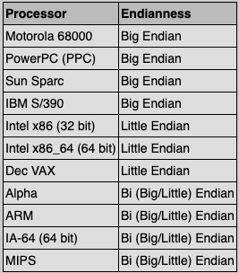
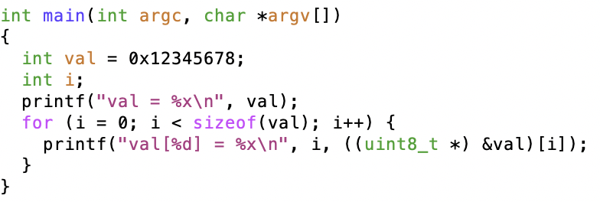
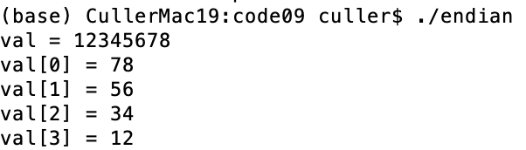
Recall: Endianness
For a byte-address machine, which end of a machine-recognized object (e.g., int) does its byte-address refer to?
Big Endian: address is the most-significant bits
Little Endian: address is the least-significant bits

Slide 4
Dealing with Endianness between Hosts
Decide on an “on-wire” endianness
Convert from native endianness to “on-wire” endianness before sending out data (serialization/marshalling)
uint32_t htonl(uint32_t) and uint16_t htons(uint16_t) convert from native endianness to network endianness (big endian)
Convert from “on-wire” endianness to native endianness when receiving data (deserialization/unmarshalling)
uint32_t ntohl(uint32_t) and uint16_t ntohs(uint16_t) convert from network endianness to native endianness (big endian)
What “endianness” is the network?
Big Endian
Network macros (htonl(), htons(), ntohl(), and ntohs()) convert for you without you needing to know one way or another.

Slide 5
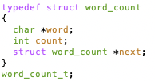
What About Richer Objects?
Consider word_count_t of Homework 0 and 1 …
Each element contains:
An int
A pointer to a string (of some length)
A pointer to the next element
fprintf_words writes these as sequence of lines (character strings with \n) to a file
What if you wanted to write the whole list as a binary object (and read it back as one)?
How do you represent the string?
Does it make any sense to write the pointer?
Marshalling involves (depending on system)
Converting values to a canonical form, serializing objects, copying arguments passed by reference, etc.
Also called “serialization”
Unmarshaling involves
Reconstructing the original object from its marshalled form at destination
Also called “deserialization”

Slide 6
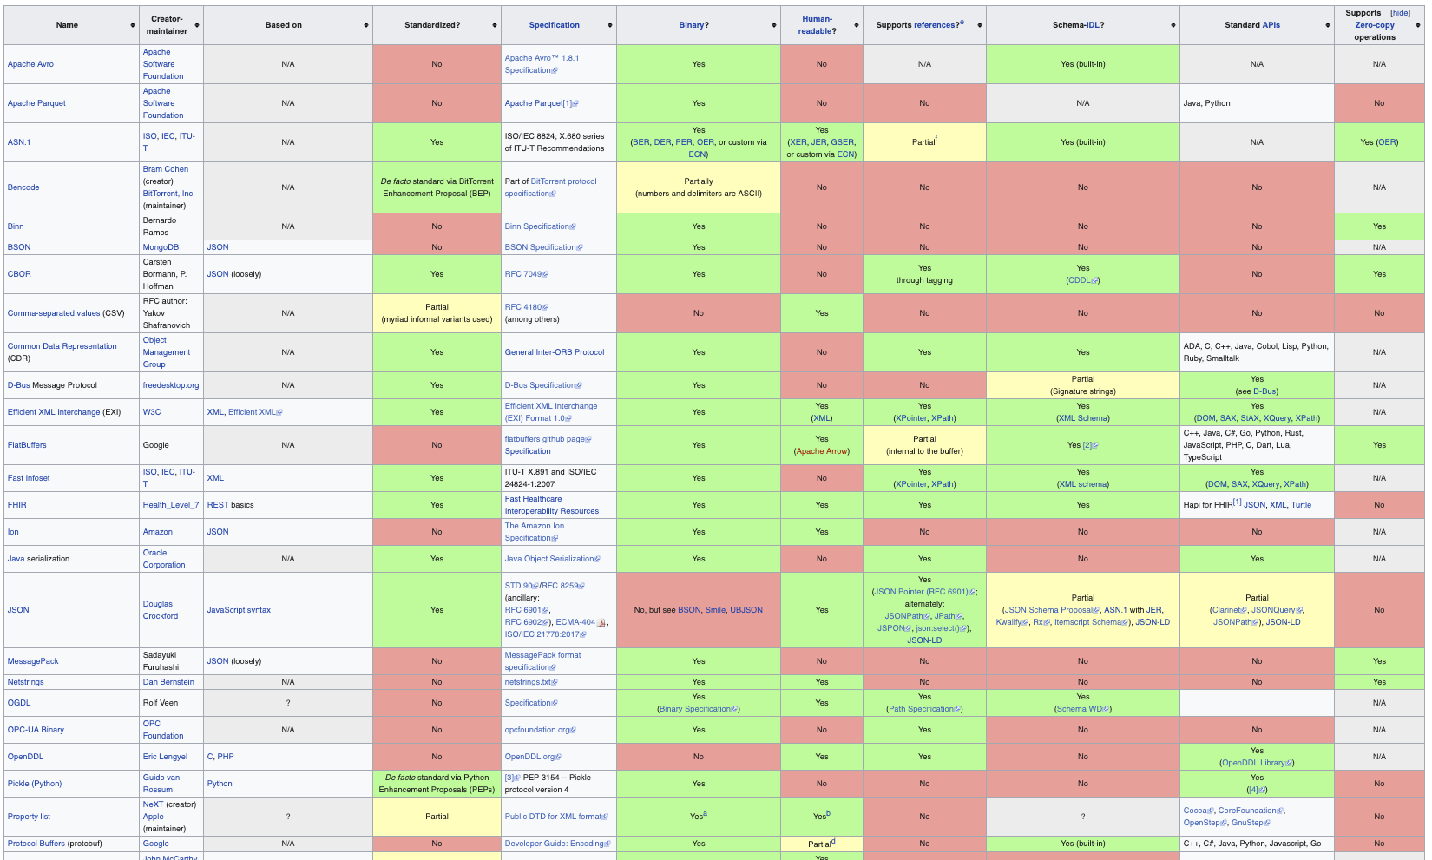
Data Serialization Formats (MANY!)

Slide 7
Remote Procedure Call (RPC)
Raw messaging is a bit too low-level for programming
Must wrap up information into message at source
Must decide what to do with message at destination
May need to sit and wait for multiple messages to arrive
And must deal with machine representation by hand
Another option: Remote Procedure Call (RPC)
Calls a procedure on a remote machine
Idea: Make communication look like an ordinary function call
Automate all of the complexity of translating between representations
Client calls: remoteFileSystem→Read("rutabaga");
Translated automatically into call on server: fileSys→Read("rutabaga");

Slide 8
RPC Concept
bundle
args
Client (caller)
r = f(v1, v2);
call
Client
Stub
send
return
receive
unbundle
ret vals
bundle
ret vals
Server (callee)
res_t f(a1, a2)
return
Server
Stub
send
call
receive
unbundle
args

Slide 9
RPC Information Flow
bundle
args
Client (caller)
r = f(v1, v2);
call
Client
Stub
send
Packet
Handler
return
receive
unbundle
ret vals
Machine A
Network
Network
Machine B
bundle
ret vals
Server (callee)
res_t f(a1, a2)
return
Server
Stub
send
Packet
Handler
Server
Stub
call
receive
unbundle
args
unbundle
args

Slide 10
RPC Details (1/3)
Request-response message passing (under covers!)
Equivalence with regular procedure call
Parameters ⇔ Request Message
Result ⇔ Reply message
Name of Procedure: Passed in request message
Return Address: mbox2 (client return mail box)
Stub generator: Compiler that generates stubs
Input: interface definitions in an “interface definition language (IDL)”
Contains, among other things, types of arguments/return
Output: stub code in the appropriate source language
Code for client to pack message, send it off, wait for result, unpack result and return to caller
Code for server to unpack message, call procedure, pack results, send them off
Notes:
…
- You might imagine that this stub code, to marshal arguments and make requests over the network, looks similar for many different remote function calls. We can actually generate it automatically, with a compiler!

Slide 11
RPC Details (2/3)
Cross-platform issues:
What if client/server machines are different architectures/ languages?
Convert everything to/from some canonical form
Tag every item with an indication of how it is encoded (avoids unnecessary conversions)
How does client know which mbox (destination queue) to send to?
Need to translate name of remote service into network endpoint (Remote machine, port, possibly other info)
Binding: the process of converting a user-visible name into a network endpoint
This is another word for “naming” at network level
Static: fixed at compile time
Dynamic: performed at runtime

Slide 12
RPC Details (3/3)
Dynamic Binding
Most RPC systems use dynamic binding via name service
Name service provides dynamic translation of service → mbox
Why dynamic binding?
Access control: check who is permitted to access service
Fail-over: If server fails, use a different one
What if there are multiple servers?
Could give flexibility at binding time
Choose unloaded server for each new client
Could provide same mbox (router level redirect)
Choose unloaded server for each new request
Only works if no state carried from one call to next
What if multiple clients?
Pass pointer to client-specific return mbox in request

Slide 13
Problems with RPC: Non-Atomic Failures
Different failure modes in dist. system than on a single machine
Consider many different types of failures
User-level bug causes address space to crash
Machine failure, kernel bug causes all processes on same machine to fail
Some machine is compromised by malicious party
Before RPC: whole system would crash/die
After RPC: One machine crashes/compromised while others keep working
Can easily result in inconsistent view of the world
Did my cached data get written back or not?
Did server do what I requested or not?
Answer? Distributed transactions/Byzantine Commit

Slide 14
Cross-Domain Communication/Location Transparency
How do address spaces communicate with one another?
Shared Memory with Semaphores, monitors, etc…
File System
Pipes (1-way communication)
“Remote” procedure call (2-way communication)
RPC’s can be used to communicate between address spaces on different machines or the same machine
Services can be run wherever it’s most appropriate
Access to local and remote services looks the same
Examples of RPC systems:
CORBA (Common Object Request Broker Architecture)
DCOM (Distributed COM)
RMI (Java Remote Method Invocation)

Slide 15
Microkernel operating systems
Example: split kernel into application-level servers.
File system looks remote, even though on same machine
Why split the OS into separate domains?
Fault isolation: bugs are more isolated (build a firewall)
Enforces modularity: allows incremental upgrades of pieces of software (client or server)
Location transparent: service can be local or remote
For example in the X windowing system: Each X client can be on a separate machine from X server; Neither has to run on the machine with the frame buffer.
App
App
App
App
File
sys
windows
file system
Windowing
address
spaces
RPC
VM
Networking
Threads
threads
Monolithic Structure
Microkernel Structure

Slide 16

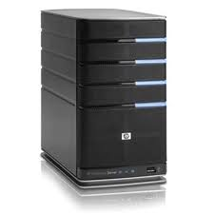
Network-Attached Storage and the CAP Theorem
Network
Consistency:
Changes appear to everyone in the same serial order
Availability:
Can get a result at any time
Partition-Tolerance
System continues to work even when network becomes partitioned
Consistency, Availability, Partition-Tolerance (CAP) Theorem: Cannot have all three at same time
Otherwise known as “Brewer’s Theorem”

Slide 17

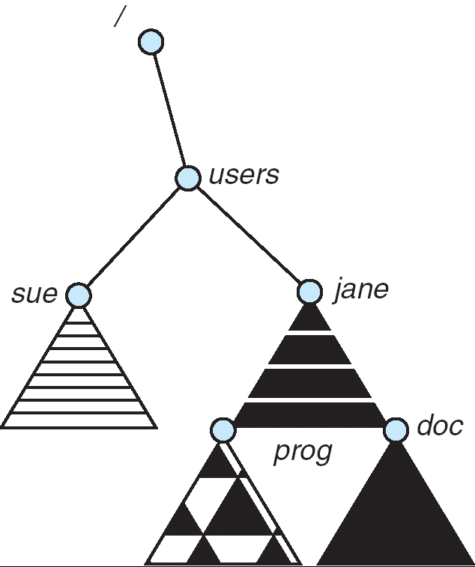
Distributed File Systems
Read File
Network
Data
Client
Server
mount
adj:/jane
Transparent access to files stored on a remote disk
Mount remote files into your local file system
Directory in local file system refers to remote files
e.g., /users/jane/prog/foo.c on laptop actually refers to /prog/foo.c on adj.cs.berkeley.edu
Naming Choices:
[Hostname,localname]: Filename includes server
No location or migration transparency, except through DNS remapping
A global name space: Filename unique in “world”
Can be served by any server
mount
coeus:/sue
mount
adj:/prog

Slide 18

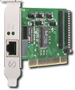
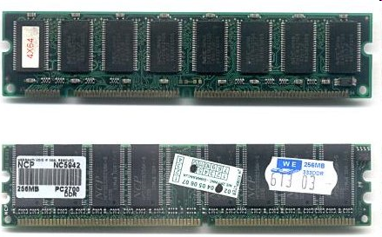
Enabling Design: VFS
The System Call Interface
Process
Management
Memory Management
Filesystems
Device Control
Networking
Concurrency, multitasking
Virtual memory
Files and dirs: the VFS
TTYs and device access
Connectivity
Architecture
Dependent
Code
Memory Manager
File System Types
Device Control
Network Subsystem
Block Devices
IF drivers

Slide 19
Recall: Layers of I/O…
User App:
length = read(input_fd, buffer, BUFFER_SIZE);
User library:
ssize_t read(int, void *, size_t) {
marshal args into registers
issue syscall
register result of syscall to rtn value
};
Application / Service
High Level I/O
Low Level I/O
Exception U→K, interrupt processing
Syscall
void syscall_handler (struct intr_frame *f) {
unmarshall call#, args from regs
dispatch : handlers[call#](args)
marshal results fo syscall ret
}
File System
I/O Driver
ssize_t vfs_read(struct file *file, char __user *buf, size_t count, loff_t *pos) {
User Process/File System relationship
call device driver to do the work
}
Device Driver

Slide 20
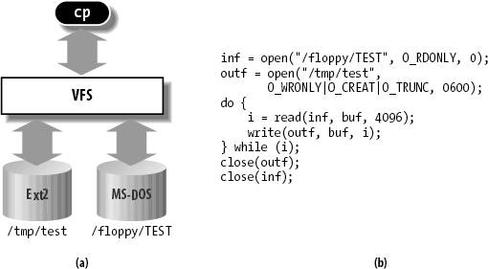
Virtual Filesystem Switch
VFS: Virtual abstraction similar to local file system
Provides virtual superblocks, inodes, files, etc
Compatible with a variety of local and remote file systems
provides object-oriented way of implementing file systems
VFS allows the same system call interface (the API) to be used for different types of file systems
The API is to the VFS interface, rather than any specific type of file system

Slide 21
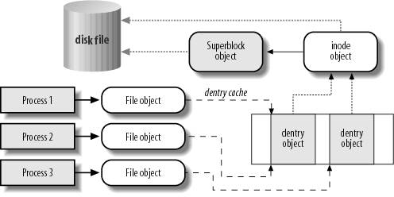
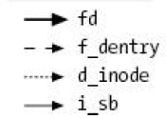
VFS Common File Model in Linux
Four primary object types for VFS:
superblock object: represents a specific mounted filesystem
inode object: represents a specific file
dentry object: represents a directory entry
file object: represents open file associated with process
There is no specific directory object (VFS treats directories as files)
May need to fit the model by faking it
Example: make it look like directories are files
Example: make it look like have inodes, superblocks, etc.

Slide 22
Simple Distributed File System
Read (RPC)
Return (Data)
Client
Write (RPC)
Server
cache
ACK
Client
Remote Disk: Reads and writes forwarded to server
Use Remote Procedure Calls (RPC) to translate file system calls into remote requests
No local caching, but can be cache at server-side
Advantage: Server provides consistent view of file system to multiple clients
Problems? Performance!
Going over network is slower than going to local memory
Lots of network traffic/not well pipelined
Server can be a bottleneck

Slide 23
Use of caching to reduce network load
Crash!
Crash!
read(f1)
→V1
cache
Read (RPC)
read(f1)→V1
read(f1)→V1
F1:V1
Return (Data)
read(f1)→V1
Client
cache
Write (RPC)
Server
F1:V1
F1:V2
ACK
cache
write(f1)
→OK
F1:V2
read(f1)→V2
Client
Idea: Use caching to reduce network load
In practice: use buffer cache at source and destination
Advantage: if open/read/write/close can be done locally, don’t need to do any network traffic…fast!
Problems:
Failure:
Client caches have data not committed at server
Cache consistency!
Client caches not consistent with server/each other

Slide 24
Dealing with Failures
What if server crashes? Can client wait until it comes back and just continue making requests?
Changes in server's cache but not in disk are lost
What if there is shared state across RPC's?
Client opens file, then does a seek
Server crashes
What if client wants to do another read?
Similar problem: What if client removes a file but server crashes before acknowledgement?

Slide 25
Stateless Protocol
Stateless Protocol: A protocol in which all information required to service a request is included with the request
Even better: Idempotent Operations – repeating an operation multiple times is same as executing it just once (e.g., storing to a mem addr.)
Client: timeout expires without reply, just run the operation again (safe regardless of first attempt)
Recall HTTP: Also a stateless protocol
Include cookies with request to simulate a session

Slide 26
Case Study: Network File System (NFS)
Three Layers for NFS system
UNIX file-system interface: open, read, write, close calls + file descriptors
VFS layer: distinguishes local from remote files
Calls the NFS protocol procedures for remote requests
NFS service layer: bottom layer of the architecture
Implements the NFS protocol
NFS Protocol: RPC for file operations on server
XDR Serialization standard for data format independence
Reading/searching a directory
manipulating links and directories
accessing file attributes/reading and writing files
Write-through caching: Modified data committed to server’s disk before results are returned to the client
lose some of the advantages of caching
time to perform write() can be long
Need some mechanism for readers to eventually notice changes! (more on this later)

Slide 27
NFS Continued
NFS servers are stateless; each request provides all arguments require for execution
E.g. reads include information for entire operation, such as ReadAt(inumber,position), not Read(openfile)
No need to perform network open() or close() on file – each operation stands on its own
Idempotent: Performing requests multiple times has same effect as performing them exactly once
Example: Server crashes between disk I/O and message send, client resend read, server does operation again
Example: Read and write file blocks: just re-read or re-write file block – no other side effects
Example: What about “remove”? NFS does operation twice and second time returns an advisory error
Failure Model: Transparent to client system
Is this a good idea? What if you are in the middle of reading a file and server crashes?
Options (NFS Provides both):
Hang until server comes back up (next week?)
Return an error. (Of course, most applications don’t know they are talking over network)

Slide 28
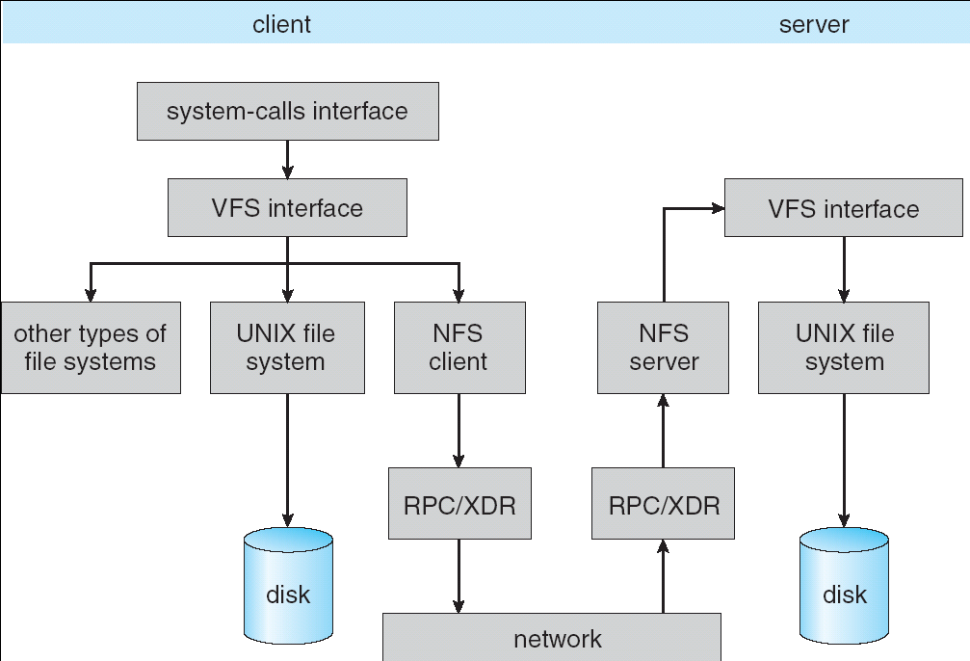
NFS Architecture

Slide 29
NFS Cache consistency
NFS protocol: weak consistency
Client polls server periodically to check for changes
Polls server if data hasn’t been checked in last 3-30 seconds (exact timeout it tunable parameter).
Thus, when file is changed on one client, server is notified, but other clients use old version of file until timeout.
What if multiple clients write to same file?
In NFS, can get either version (or parts of both)
Completely arbitrary!
cache
F1 still ok?
F1:V2
F1:V1
No: (F1:V2)
Client
cache
Write (RPC)
Server
F1:V2
ACK
cache
F1:V2
Client

Slide 30
What about: Sharing Data, rather than Files ?
Key:Value stores are used everywhere
Native in many programming languages
Associative Arrays in Perl
Dictionaries in Python
Maps in Go
…
What about a collaborative key-value store rather than message passing or file sharing?
Can we make it scalable and reliable?

Slide 31
Key Value Storage
Simple interface
put(key, value); // Insert/write "value" associated with key
get(key); // Retrieve/read value associated with key

Slide 32
Why Key Value Storage?
Easy to Scale
Handle huge volumes of data (e.g., petabytes)
Uniform items: distribute easily and roughly equally across many machines
Simple consistency properties
Used as a simpler but more scalable "database"
Or as a building block for a more capable DB

Slide 33





Key Values: Examples
Amazon:
Key: customerID
Value: customer profile (e.g., buying history, credit card, ..)
Facebook, Twitter:
Key: UserID
Value: user profile (e.g., posting history, photos, friends, …)
iCloud/iTunes:
Key: Movie/song name
Value: Movie, Song

Slide 34
Key-value storage systems in real life
Amazon
DynamoDB: internal key value store used to power Amazon.com (shopping cart)
Simple Storage System (S3)
BigTable/HBase/Hypertable: distributed, scalable data storage
Cassandra: “distributed data management system” (developed by Facebook)
Memcached: in-memory key-value store for small chunks of arbitrary data (strings, objects)
eDonkey/eMule: peer-to-peer sharing system
…

Slide 35
Key Value Store
Also called Distributed Hash Tables (DHT)
Main idea: simplify storage interface (i.e. put/get), then partition set of key-values across many machines
key, value
…

Slide 36
Challenges
…
Scalability:
Need to scale to thousands of machines
Need to allow easy addition of new machines
Fault Tolerance: handle machine failures without losing data and without degradation in performance
Consistency: maintain data consistency in face of node failures and message losses
Heterogeneity (if deployed as peer-to-peer systems):
Latency: 1ms to 1000ms
Bandwidth: 32Kb/s to 100Mb/s

Slide 37
Important Questions
put(key, value):
where do you store a new (key, value) tuple?
get(key):
where is the value associated with a given “key” stored?
And, do the above while providing
Scalability
Fault Tolerance
Consistency

Slide 38
How to solve the “where?”
Hashing to map key space ⇒ location
But what if you don’t know all the nodes that are participating?
Perhaps they come and go …
What if some keys are really popular?
Lookup
Hmm, won’t this be a bottleneck and single point of failure?

Slide 39
Recursive Directory Architecture (put)
Have a node maintain the mapping between keys and the machines (nodes) that store the values associated with the keys
Master/Directory
put(K14, V14)
K5
N2
K14
N3
K105
N50
put(K14, V14)
K5
V5
K14
V14
K105
V105
…
N₁
N₂
N₃
N₅₀

Slide 40
Recursive Directory Architecture (get)
Have a node maintain the mapping between keys and the machines (nodes) that store the values associated with the keys
Master/Directory
get(K14)
K5
N2
V14
K14
N3
K105
N50
get(K14)
V14
K5
V5
K14
V14
K105
V105
…
N₁
N₂
N₃
N₅₀

Slide 41
Iterative Directory Architecture (put)
Having the master relay the requests → recursive query
Another method: iterative query (this slide)
Return node to requester and let requester contact node
Master/Directory
put(K14, V14)
K5
N2
N3
K14
N3
K105
N50
put(K14, V14)
K5
V5
K14
V14
K105
V105
…
N₁
N₂
N₃
N₅₀

Slide 42
Iterative Directory Architecture (get)
Having the master relay the requests → recursive query
Another method: iterative query (this slide)
Return node to requester and let requester contact node
Master/Directory
get(K14)
N3
K5
N2
K14
N3
V14
K105
N50
get(K14)
K5
V5
K14
V14
K105
V105
…
N₁
N₂
N₃
N₅₀

Slide 43
Iterative vs. Recursive Query
Master/Directory
Master/Directory
get(K14)
get(K14)
V14
K14
N3
N3
K14
N3
V14
get(K14)
get(K14)
V14
K14
V14
K14
V14
…
…
N1
N2
N3
N50
N1
N2
N3
N50
Recursive
Iterative
Faster, as directory server is typically close to storage nodes
Easier for consistency: directory can enforce an order for all puts and gets
Directory is a performance bottleneck
More scalable, clients do more work
Harder to enforce consistency

Slide 44
Fault Tolerance
Replicate value on several nodes
Usually, place replicas on different racks in a datacenter to guard against rack failures
Master/Directory
put(K14, V14)
K5
N2
N1, N3
K14
N1,N3
K105
N50
put(K14, V14)
put(K14, V14), N1
K14
V14
K5
V5
K14
V14
K105
V105
…
N₁
N₂
N₃
N₅₀

Slide 45
Scalability
Storage: use more nodes
Number of requests:
Can serve requests from all nodes on which a value is stored in parallel
Master can replicate a popular value on more nodes
Master/directory scalability:
Replicate it
Partition it, so different keys are served by different masters/directories
How do you partition?

Slide 46
Scaling Up Directory
Challenge:
Directory contains a number of entries equal to number of (key, value) tuples in the system
Can be tens or hundreds of billions of entries in the system!
Solution: Consistent Hashing
Provides mechanism to divide [key,value] pairs amongst a (potentially large!) set of machines (nodes) on network
Associate to each node a unique id in an uni-dimensional space 0..2^{m}-1 ⇒ Wraps around: Call this “the ring!”
Partition this space across n machines
Assume keys are in same uni-dimensional space
Each [Key, Value] is stored at the node with the smallest ID larger than Key

Slide 47
Key to Node Mapping Example
Paritioning example with m = 6 → ID space: 0..63
Node 8 maps keys [5,8]
Node 15 maps keys [9,15]
Node 20 maps keys [16, 20]
…
Node 4 maps keys [59, 4]
For this example, the mapping [14, V14] maps to node with ID=15
Node with smallest ID larger than 14 (the key)
In practice, m=256 or more!
Uses cryptographically secure hash such as SHA-256 to generate the node IDs
63
0
4
58
8
14
V14
“The Ring”
15
44
20
35
32

Slide 48
Chord: Distributed Lookup (Directory) Service
“Chord” is a Distributed Lookup Service
Designed at MIT and here at Berkeley (Ion Stoica among others)
Simplest and cleanest algorithm for distributed storage
Serves as comparison point for other optims
Import aspect of the design space:
Decouple correctness from efficiency
Combined Directory and Storage
Properties
Correctness:
Each node needs to know about neighbors on ring (one predecessor and one successor)
Connected rings will perform their task correctly
Performance:
Each node needs to know about O(log(M)), where M is the total number of nodes
Guarantees that a tuple is found in O(log(M)) steps
Many other Structured, Peer-to-Peer lookup services:
CAN, Tapestry, Pastry, Bamboo, Kademlia, …
Several designed here at Berkeley!

Slide 49
Chord’s Lookup Mechanism: Routing!
Each node maintains pointer to its successor
Route packet (Key, Value) to the node responsible for ID using successor pointers
E.g., node=4 lookups for node responsible for Key=37
Worst-case (correct) lookup is O(n)
But much better normal lookup time is O(log n)
Dynamic performance optimization (finger table mechanism)
More later!!!
lookup(37)
4
58
8
node=44 is responsible for Key=37
15
44
20
35
32

Slide 50


But what does this really mean??
ID: 58
Client
Client
ID: 4
63
0
4
ID: 20
58
8
14
V14
Client
ID: 32
ID: 35
15
ID: 15
ID: 8
44
20
14
V14
ID: 44
35
32
Client
Client
Node names intentionally scrambled WRT geography!
Node IDs generated by secure hashes over metadata
Including things like the IP address
This geographic scrambling spreads load and avoids hotspots
Clients access distributed storage through any member of the network

Slide 51
Stabilization Procedure
Periodic operation performed by each node n to maintain its successor when new nodes join the system
The primary Correctness constraint
n.stabilize()
x = succ.pred;
if (x (n, succ))
succ = x; // if x better successor, update
succ.notify(n); // n tells successor about itself
n.notify(n’)
if (pred = nil or n’ (pred, n))
pred = n’; // if n’ is better predecessor, update

Slide 52
Joining Operation
Node with id=50 joins the ring
Node 50 must know at least one node already in system
Assume known node is 15
succ=4
pred=44
4
58
8
succ=nil
pred=nil
50
15
44
succ=58
20
pred=35
35
32

Slide 53
Joining Operation
n=50 sends join(50) to node 15
Join propagated around ring!
n=44 returns node 58
n=50 updates its successor to 58
succ=4
pred=44
4
58
8
join(50)
succ=nil
succ=58
pred=nil
50
58
15
44
succ=58
20
pred=35
35
32

Slide 54
Joining Operation
n=50 executes stabilize()
n’s successor (58) returns x = 44
succ=4
pred=44
4
x=44
58
8
succ=58
pred=nil
15
50
44
succ=58
20
pred=35
n.stabilize()
x = succ.pred;
if (x (n, succ))
succ = x;
succ.notify(n);
35
32

Slide 55
Joining Operation
n=50 executes stabilize()
x = 44
succ = 58
succ=4
pred=44
4
58
8
succ=58
pred=nil
15
50
44
succ=58
20
pred=35
n.stabilize()
x = succ.pred;
if (x (n, succ))
succ = x;
succ.notify(n);
35
32

Slide 56
Joining Operation
n=50 executes stabilize()
x = 44
succ = 58
n=50 sends to it’s successor (58) notify(50)
succ=4
pred=44
4
58
notify(50)
8
succ=58
pred=nil
15
50
44
succ=58
20
pred=35
n.stabilize()
x = succ.pred;
if (x (n, succ))
succ = x;
succ.notify(n);
35
32

Slide 57
Joining Operation
n=58 executes notify(50)
pred = 44
n’ = 50
succ=4
pred=44
4
58
notify(50)
8
succ=58
pred=nil
15
50
44
succ=58
20
pred=35
n.notify(n’)
if (pred = nil or n’ ∈ (pred, n))
pred = n’
35
32

Slide 58
Joining Operation
n=58 executes notify(50)
pred = 44
n’ = 50
set pred = 50
succ=4
pred=44
pred=50
4
58
notify(50)
8
succ=58
pred=nil
15
50
44
succ=58
20
pred=35
n.notify(n’)
if (pred = nil or n’ ∈ (pred, n))
pred = n’
35
32

Slide 59
Joining Operation
n=44 executes stabilize()
n’s successor (58) returns x=50
succ=4
pred=50
4
58
8
x=50
succ=58
pred=nil
15
50
44
succ=58
20
pred=35
n.stabilize()
x = succ.pred;
if (x (n, succ))
succ = x;
succ.notify(n);
35
32

Slide 60
Joining Operation
n=44 executes stabilize()
x=50
succ=58
succ=4
pred=50
4
58
8
succ=58
pred=nil
15
50
44
succ=58
20
pred=35
n.stabilize()
x = succ.pred;
if (x (n, succ))
succ = x;
succ.notify(n);
35
32

Slide 61
Joining Operation
n=44 executes stabilize()
x=50
succ=58
n=44 sets succ=50
succ=4
pred=50
4
58
8
succ=58
pred=nil
15
50
44
succ=50
succ=58
20
pred=35
n.stabilize()
x = succ.pred;
if (x (n, succ))
succ = x;
succ.notify(n);
35
32

Slide 62
Joining Operation
n=44 executes stabilize()
n=44 sends notify(44) to its successor
succ=4
pred=50
4
58
8
succ=58
pred=nil
15
50
notify(44)
44
succ=50
20
pred=35
n.stabilize()
x = succ.pred;
if (x (n, succ))
succ = x;
succ.notify(n);
35
32

Slide 63
Joining Operation
n=50 executes notify(44)
pred=nil
succ=4
pred=50
4
58
8
succ=58
pred=nil
15
50
notify(44)
44
succ=50
20
pred=35
n.notify(n’)
if (pred = nil or n’ (pred, n))
pred = n’
35
32

Slide 64
Joining Operation
n=50 executes notify(44)
pred=nil
n=50 sets pred=44
succ=4
pred=50
4
58
8
succ=58
pred=nil
pred=44
15
50
notify(44)
44
succ=50
20
pred=35
n.notify(n’)
if (pred = nil or n’ ∈ (pred, n))
pred = n’
35
32

Slide 65
Joining Operation (cont’d)
This completes the joining operation!
The same stabilizing process will deal with failed nodes by reconnecting the ring
What if 2 or more nodes in a row fail?
Keep track of more neighbors!
Called the “leaf set”
pred=50
4
58
8
succ=58
50
pred=44
15
44
20
succ=50
35
32

Slide 66
Achieving Efficiency: finger tables
Say m=7
Finger Table at 80
0
i ft[i]
0 96
1 96
2 96
3 96
4 96
5 112
6 20
(80 + 2⁶) mod 2⁷ = 16
80 + 2⁵
112
20
96
80 + 2⁴
32
80 + 2³
80 + 2²
80 + 2¹
45
80 + 2⁰
80
ith entry at peer with id n is first peer with id >=

Slide 67
Achieving Fault Tolerance for Lookup Service
To improve robustness each node maintains the k (> 1) immediate successors instead of only one successor
Again – called the “leaf set”
In the pred() reply message, node A can send its k-1 successors to its predecessor B
Upon receiving pred() message, B can update its successor list by concatenating the successor list received from A with its own list
If k = log(M), lookup operation works with high probability even if half of nodes fail, where M is number of nodes in the system

Slide 68
Storage Fault Tolerance
Replicate tuples on successor nodes
Example: replicate (K14, V14) on nodes 20 and 32
63
0
4
58
8
14
V14
15
14
V14
44
20
14
V14
35
32

Slide 69
Storage Fault Tolerance
If node 15 fails, no reconfiguration needed
Still have two replicas
All lookups will be correctly routed after stabilization
Will need to add a new replica on node 35
63
0
4
58
8
14
V14
15
14
V14
44
14
V14
20
14
V14
35
32

Slide 70
Replication in Physical Space
ID: 58
Client
Client
14
V14
ID: 4
63
14
V14
0
4
ID: 20
58
8
14
V14
Client
ID: 32
ID: 35
15
14
V14
ID: 15
ID: 8
44
20
14
V14
14
V14
Client
ID: 44
35
32
Client
Replicating in Adjacent nodes of virtual space ⇒ Geographic Separation in physical space
Avoids single-points of failure through randomness
More nodes, more replication, more geographic spread

Slide 71
Consistency
Need to make sure that a value is replicated correctly
How do you know a value has been replicated on every node?
Wait for acknowledgements from every node
What happens if a node fails during replication?
Pick another node and try again
What happens if a node is slow?
Slow down the entire put()? Pick another node?
In general, with multiple replicas
Slow puts and fast gets

Slide 72
Consistency (cont’d)
If concurrent updates (i.e., puts to same key) may need to make sure that updates happen in the same order
Master/Directory
put(K14, V14’)
K5
N2
put(K14, V14’’)
K14
N1,N3
K105
N50
put(K14, V14’’)
put(K14, V14’)
K14
K14
V14
V14’’
K5
V5
K14
K14
V14
V14’
K105
V105
…
N₁
N₂
N₃
N₅₀

Slide 73
Consistency (cont’d)
If concurrent updates (i.e., puts to same key) may need to make sure that updates happen in the same order
put(K14, V14’) and put(K14, V14’’) reach N1 & N3 in reverse order!
Master/Directory
put(K14, V14’)
K5
N2
put(K14, V14’’)
K14
N1,N3
K105
N50
put(K14, V14’’)
put(K14, V14’)
put(K14, V14’')
put(K14, V14’)
K14
K14
V14
V14’
K5
V5
K14
K14
V14
V14’’
K105
V105
…
N₁
N₂
N₃
N₅₀

Slide 74
Consistency (cont’d)
If concurrent updates (i.e., puts to same key) may need to make sure that updates happen in the same order
put(K14, V14’) and put(K14, V14’’) reach N1 & N3 in reverse order!
What does get(K14) return?
Undefined!
Master/Directory
put(K14, V14’)
K5
N2
put(K14, V14’’)
K14
N1,N3
K105
N50
put(K14, V14’’)
put(K14, V14’)
put(K14, V14’')
put(K14, V14’)
K14
K14
V14
V14’
K5
V5
K14
K14
V14
V14’’
K105
V105
…
N₁
N₂
N₃
N₅₀

Slide 75
Large Variety of Consistency Models
Atomic consistency (linearizability): reads/writes (gets/puts) to replicas appear as if there was a single underlying replica (single system image)
Think “one updated at a time”
Transactions
Eventual consistency: given enough time all updates will propagate through the system
One of the weakest form of consistency; used by many systems in practice
Must eventually converge on single value/key (coherence)
And many others: causal consistency, sequential consistency, strong consistency, …

Slide 76
Quorum Consensus
Improve put() and get() operation performance
In the presence of replication!
Define a replica set of size N
put() waits for acknowledgements from at least W replicas
Different updates need to be differentiated by something monotonically increasing like a timestamp
Allows us to replace old values with updated ones
get() waits for responses from at least R replicas
W+R > N
Why does it work?
There is at least one node that contains the update
Why might you use W+R > N+1?

Slide 77
Quorum Consensus Example
N=3, W=2, R=2
Replica set for K14: {N1, N2, N4}
Assume put() on N3 fails
put(K14, V14)
put(K14, V14)
put(K14, V14)
ACK
ACK
K14
V14
K14
V14
N₁
N₂
N₃
N₄

Slide 78
Quorum Consensus Example
Now, issuing get() to any two nodes out of three will return the answer
get(K14)
get(K14)
V14
nill
K14
V14
K14
V14
N₁
N₂
N₃
N₄

Slide 79
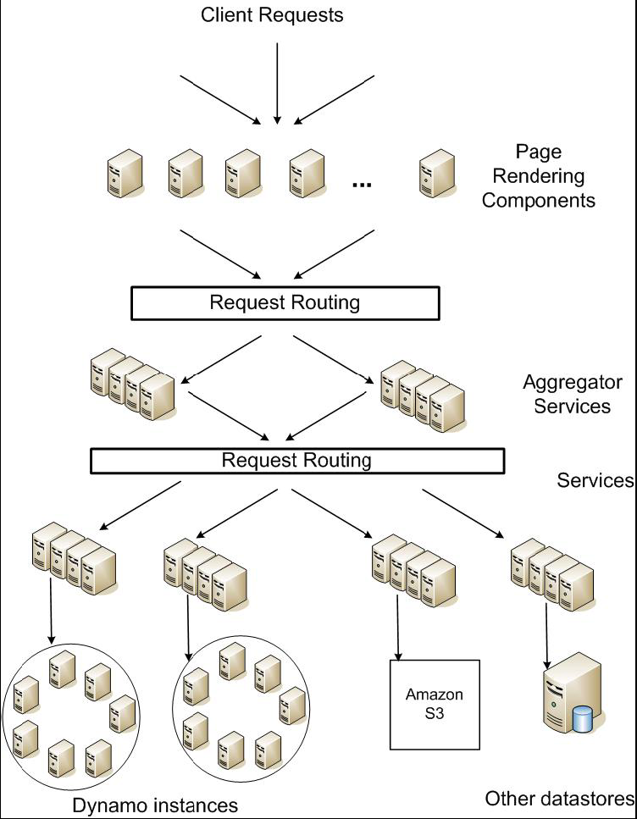
DynamoDB Example: Service Level Agreements (SLA)
Dynamo is Amazon’s storage system using “Chord” ideas
Application can deliver its functionality in a bounded time:
Every dependency in the platform needs to deliver its functionality with even tighter bounds.
Example: service guaranteeing that it will provide a response within 300ms for 99.9% of its requests for a peak client load of 500 requests per second
Contrast to services which focus on mean response time
Service-oriented architecture of
Amazon’s platform

Slide 80
Quantum Computing, Shor’s Algorithm, and the role of CAD design

Slide 81
Use Quantum Mechanics to Compute?
Weird but useful properties of quantum mechanics:
Quantization: Only certain values or orbits are good
Remember orbitals from chemistry???
Superposition: Schizophrenic physical elements don’t quite know whether they are one thing or another
All existing digital abstractions try to eliminate QM
Transistors/Gates designed with classical behavior
Binary abstraction: a “1” is a “1” and a “0” is a “0”
Quantum Computing: Use of Quantization and Superposition to compute.
Interesting results:
Shor’s algorithm: factors in polynomial time!
Grover’s algorithm: Finds items in unsorted database in time proportional to square-root of n.
Materials simulation: exponential classically, linear-time QM

Slide 82
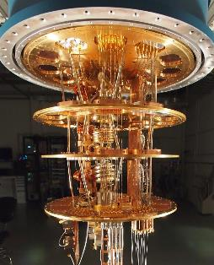
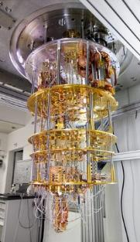
Current “Arms Race” of Quantum Computing
Google: Superconducting Devices up 72-qubits
IBM: Superconducting
Devices up to 50 qubits
Big companies looking at Quantum Computing Seriously
Google, IBM, Microsoft
Current Goal: Quantum Supremacy
Show that Quantum Computers faster than Classical ones
“If a quantum processor can be operated with low enough error, it would be able to outperform a classical supercomputer on a well-defined computer science problem, an achievement known as quantum supremacy.”

Slide 83
Quantization: Use of “Spin”
North
Spin ½ particle:
(Proton/Electron)
Representation:
|0> or |1>
South
Particles like Protons have an intrinsic “Spin” when defined with respect to an external magnetic field
Quantum effect gives “1” and “0”:
Either spin is “UP” or “DOWN” nothing between

Slide 84
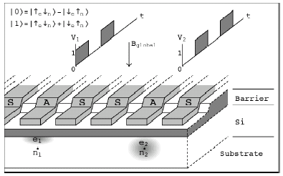
Kane Proposal II (First one didn’t quite work)
Single Spin
Control Gates
Inter-bit
Control Gates
Phosphorus
Impurity Atoms
Bits Represented by combination of proton/electron spin
Operations performed by manipulating control gates
Complex sequences of pulses perform NMR-like operations
Temperature < 1° Kelvin!

Slide 85
Now add Superposition!
The bit can be in a combination of “1” and “0”:
Written as: Ψ= C₀|0> + C₁|1>
The C’s are complex numbers!
Important Constraint: |C₀|² + |C₁|² =1
If measure bit to see what looks like,
With probability |C₀|² we will find |0> (say “UP”)
With probability |C₁|² we will find |1> (say “DOWN”)
Is this a real effect? Options:
This is just statistical – given a large number of protons, a fraction of them (|C₀|² ) are “UP” and the rest are down.
This is a real effect, and the proton is really both things until you try to look at it
Reality: second choice!
There are experiments to prove it!

Slide 86
A register can have many values!
Implications of superposition:
An n-bit register can have 2^{n} values simultaneously!
3-bit example:
Ψ= C₀₀₀|000>+ C₀₀₁|001>+ C₀₁₀|010>+ C₀₁₁|011>+ C₁₀₀|100>+ C₁₀₁|101>+ C₁₁₀|110>+ C₁₁₁|111>
Probabilities of measuring all bits are set by coefficients:
So, prob of getting |000> is |C₀₀₀|², etc.
Suppose we measure only one bit (first):
We get “0” with probability: P₀=|C₀₀₀|²+ |C₀₀₁|²+ |C₀₁₀|²+ |C₀₁₁|² Result: Ψ= (C₀₀₀|000>+ C₀₀₁|001>+ C₀₁₀|010>+ C₀₁₁|011>)
We get “1” with probability: P₁=|C₁₀₀|²+ |C₁₀₁|²+ |C₁₁₀|²+ |C₁₁₁|² Result: Ψ= (C₁₀₀|100>+ C₁₀₁|101>+ C₁₁₀|110>+ C₁₁₁|111>)
Problem: Don’t want environment to measure before ready!
Solution: Quantum Error Correction Codes!

Slide 87
Spooky action at a distance
Consider the following simple 2-bit state:
Ψ= C₀₀|00>+ C₁₁|11>
Called an “EPR” pair for “Einstein, Podolsky, Rosen”
Now, separate the two bits:
If we measure one of them, it instantaneously sets other one!
Einstein called this a “spooky action at a distance”
In particular, if we measure a |0> at one side, we get a |0> at the other (and vice versa)
Teleportation
Can “pre-transport” an EPR pair (say bits X and Y)
Later to transport bit A from one side to the other we:
Perform operation between A and X, yielding two classical bits
Send the two bits to the other side
Use the two bits to operate on Y
Poof! State of bit A appears in place of Y
Light-Years?

Slide 88
Model: Operations on coefficients + measurements
Input
Complex
State
Unitary
Transformations
Measure
Output
Classical
Answer
Basic Computing Paradigm:
Input is a register with superposition of many values
Possibly all 2n inputs equally probable!
Unitary transformations compute on coefficients
Must maintain probability property (sum of squares = 1)
Looks like doing computation on all 2n inputs simultaneously!
Output is one result attained by measurement
If do this poorly, just like probabilistic computation:
If 2n inputs equally probable, may be 2n outputs equally probable.
After measure, like picked random input to classical function!
All interesting results have some form of “fourier transform” computation being done in unitary transformation

Slide 89
Shor’s Factoring Algorithm
The Security of RSA Public-key cryptosystems depends on the difficulty of factoring a number N=pq (product of two primes)
Classical computer: sub-exponential time factoring
Quantum computer: polynomial time factoring
Shor’s Factoring Algorithm (for a quantum computer)
Choose random x : 2 ≤ x ≤ N-1.
If gcd(x,N) ≠ 1, Bingo!
Find smallest integer r : x^{r} ≡ 1 (mod N)
If r is odd, Repeat at Step 1
If r is even, a ≡ x ^{r/2} (mod N) ⇒ (a-1)×(a+1) = kN
If a ≡ N-1(mod N) GOTO 1
ELSE gcd(a ± 1,N) is a non trivial factor of N.
Easy
Easy
Hard
Easy
Easy
Easy
Easy

Slide 90
Finding r with x^{r} ≡ 1 (mod N)
Quantum
Fourier
Transform
Finally: Perform measurement
Find out r with high probability
Get |y>|a^{w’}> where y is of form k/r and w’ is related

Slide 91
Quantum Computing Architectures
Why study quantum computing?
Interesting, says something about physics
Failure to build ⇒ quantum mechanics wrong?
Mathematical Exercise (perfectly good reason)
Hope that it will be practical someday:
Shor’s factoring, Grover’s search, Design of Materials
Quantum Co-processor included in your Laptop?
To be practical, will need to hand quantum computer design off to classical designers
Baring Adiabatic algorithms, will probably need 100s to 1000s (millions?) of working logical Qubits ⇒ 1000s to millions of physical Qubits working together
Current chips: ~1 billion transistors!
Large number of components is realm of architecture
What are optimized structures of quantum algorithms when they are mapped to a physical substrate?
Optimization not possible by hand
Abstraction of elements to design larger circuits
Lessons of last 30 years of VLSI design: USE CAD

Slide 92
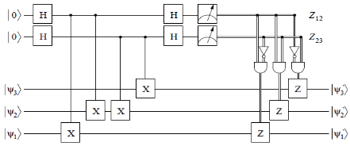
Quantum Circuit Model
Quantum Circuit model – graphical representation
Time Flows from left to right
Single Wires: persistent Qubits, Double Wires: classical bits
Qubit – coherent combination of 0 and 1: ψ = α|0⟩ + β|1⟩
Universal gate set: Sufficient to form all unitary transformations
Example: Syndrome Measurement (for 3-bit code)
Measurement (meter symbol) produces classical bits
Quantum CAD
Circuit expressed as netlist
Computer manpulated circuits and implementations

Slide 93
Adding Quantum ECC
T:
Encoded
π/8 (T)
Ancilla
Correct
SX
Not Transversal!
T
Correct
X
T
Correct
Correct
Correct
n-physical Qubits per logical Qubit
H
H
Correct
Correct
Correct
Syndrome
Computation
Quantum State Fragile ⇒ encode all Qubits
Uses many resources: e.g. 3-level [[7,1,3]] code 343 physical Qubits/logical Qubit)!
Still need to handle operations (fault-tolerantly)
Some set of gates are simply “transversal:”
Perform identical gate between each physical bit of logical encoding
Others (like T gate for [[7,1,3]] code) cannot be handled transversally
Can be performed fault-tolerantly by preparing appropriate ancilla
Finally, need to perform periodical error correction
Correct after every(?): Gate, Long distance movement, Long Idle Period
Correction reducing entropy ⇒ Consumes Ancilla bits
Observation: ≥ 90% of QEC gates are used for ancilla production ≥ 70-85% of all gates are used for ancilla production
Correct
Errors
QEC
Ancilla
Correct

Slide 94
MEMs-Based Ion Trap Devices
Ion Traps: One of the more promising quantum computer implementation technologies
Built on Silicon
Can bootstrap the vast infrastructure that currently exists in the microchip industry
Seems to be on a “Moore’s Law” like scaling curve
Many researchers working on this problem
Some optimistic researchers speculate about room temperature
Properties:
Has a long-distance Wire
So-called “ballistic movement”
Seems to have relatively long decoherence times
Seems to have relatively low error rates for:
Memory, Gates, Movement

Slide 95
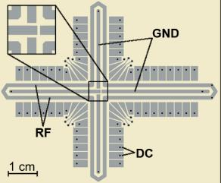
Quantum Computing with Ion Traps
Qubits are atomic ions (e.g. Be⁺)
State is stored in hyperfine levels
Ions suspended in channels between electrodes
Quantum gates performed by lasers (either one or two bit ops)
Only at certain trap locations
Ions move between laser sites to perform gates
Classical control
Gate (laser) ops
Movement (electrode) ops
Complex pulse sequences to cause Ions to migrate
Care must be taken to avoid disturbing state
Demonstrations in the Lab
NIST, MIT, Michigan, many others
Electrode Control
Qubit Ions
Electrodes
Gate Location
Courtesy of Chuang group, MIT
Notes:
If we are going to talk about automating design of quantum circuit layouts, we need to first talk about the underlying technology model

Slide 96
An Abstraction of Ion Traps
Basic block abstraction: Simplify Layout
Evaluation of layout through simulation
Yields Computation Time and Probability of Success
Simple Error Model: Depolarizing Errors
Errors for every Gate Operation and Unit of Waiting
Ballistic Movement Error: Two error Models
Every Hop/Turn has probability of error
Only Accelerations cause error
in/out ports
straight
3-way
4-way
turn
gate locations

Slide 97
Ion Trap Physical Layout
Input: Gate level quantum circuit
Bit lines
1-qubit gates
2-qubit gates
Output:
Layout of channels
Gate locations
Initial locations of ions
Movement/gate schedule
Control for schedule
Time
q0
q1
q2
Qubits
q3
q4
q5
q6
q0
q6
q5
q2
q1
q3
q4
Notes:
This paper focuses on the automation of physical layout of ion traps, here is a more precise definition of the problem we are solving

Slide 98
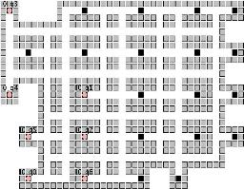
Vision of Quantum Circuit Design
Schematic Capture (Graphical Entry)
QEC Insertion
Partitioning
Layout
Network Insertion
Error Analysis
…
Optimization
Classical Control
Teleportation Network
OR
Custom Layout and
Scheduling
CAD Tool Implementation
Quantum Assembly
(QASM)

Slide 99
Important Measurement Metrics
Traditional CAD Metrics:
Area
What is the total area of a circuit?
Measured in macroblocks (ultimately μm² or similar)
Latency (Latency_{single})
What is the total latency to compute circuit once
Measured in seconds (or μs)
Probability of Success (P_{success})
Not common metric for classical circuits
Account for occurrence of errors and error correction
Quantum Circuit Metric: ADCR
Area-Delay to Correct Result: Probabilistic Area-Delay metric
ADCR = Area × E(Latency) =
ADCR_{optimal}: Best ADCR over all configurations
Optimization potential: Equipotential designs
Trade Area for lower latency
Trade lower probability of success for lower latency

Slide 100
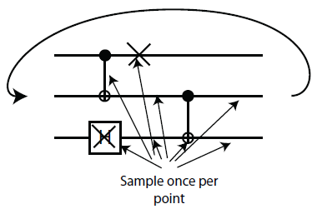
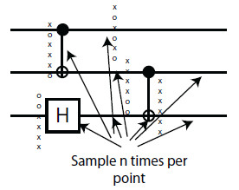
How to evaluate a circuit?
First, generate a physical instance of circuit
Encode the circuit in one or more QEC codes
Partition and layout circuit: Highly dependant of layout heuristics!
Create a physical layout and scheduling of bits
Yields area and communication cost
Then, evaluate probability of success
Technique that works well for depolarizing errors: Monte Carlo
Possible error points: Operations, Idle Bits, Communications
Vectorized Monte Carlo: n experiments with one pass
Need to perform hybrid error analysis for larger circuits
Smaller modules evaluated via vector Monte Carlo
Teleportation infrastructure evaluated via fidelity of EPR bits
Finally – Compute ADCR for particular result
Normal
Monte Carlo:
n times
Vector
Monte Carlo:
single pass

Slide 101
Quantum CAD flow
Input Circuit
QEC Insert
Circuit Synthesis
QEC Optimization
Fault-Tolerant
Circuit
(No layout)
Fault Tolerant
ReSynthesis (ADCR_{optimal})
Circuit
Partitioning
Communication
Estimation
Teleportation
Network Insertion
Mapping, Scheduling,
Classical control
Partitioned
Circuit
Functional System
ReMapping
Hybrid Fault
Analysis
Output Layout
Error Analysis
Most Vulnerable Circuits
Complete Layout
P_{success}
ADCR computation

Slide 102
Comparison of 1024-bit adders
ADCR_{optimal} for 1024-bit QRCA and QCLA
ADCR_{optimal} for 1024-bit QCLA
1024-bit Quantum Adder Architectures
Ripple-Carry (QRCA)
Carry-Lookahead (QCLA)
Carry-Lookahead is better in all architectures
QEC Optimization improves ADCR by order of magnitude in some circuit configurations

Slide 103
Area Breakdown for Adders
Error Correction is not predominant use of area
Only 20-40% of area devoted to QEC ancilla
For Optimized Qalypso QCLA, 70% of operations for QEC ancilla generation, but only about 20% of area
T-Ancilla generation is major component
Often overlooked
Networking is significant portion of area when allowed to optimize for ADCR (30%)
CQLA and QLA variants didn’t really allow for much flexibility

Slide 104
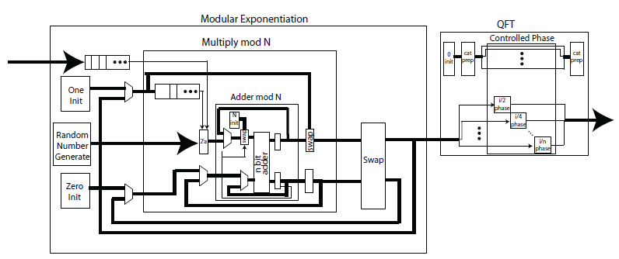
Investigating 1024-bit Shor’s
Full Layout of all Elements
Use of 1024-bit Quantum Adders
Optimized error correction
Ancilla optimization and Custom Network Layout
Statistics:
Unoptimized version: 1.35×10¹⁵ operations
Optimized Version 1000X smaller
QFT is only 1% of total execution time

Slide 105
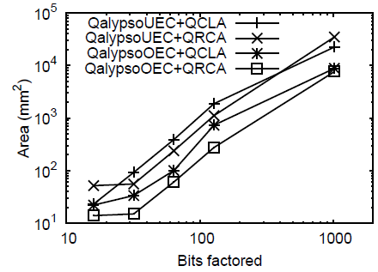
1024-bit Shor’s Continued
Circuits too big to compute P_{success}
Working on this problem
Fastest Circuit: 6×10⁸ seconds ~ 19 years
Speedup by classically computing recursive squares?
Smallest Circuit: 7659 mm²
Compare to previous estimate of 0.9 m² = 9×10⁵ mm²

Slide 106
Summary (1/2)
Remote Procedure Call (RPC): Call procedure on remote machine or in remote domain
Provides same interface as procedure
Automatic packing and unpacking of arguments without user programming (in stub)
Adapts automatically to different hardware and software architectures at remote end
Key-Value Store:
Two operations
put(key, value)
value = get(key)
Challenges
Fault Tolerance → replication
Scalability → serve get()’s in parallel; replicate/cache hot tuples
Consistency → quorum consensus to improve put() performance
Distributed File System:
Transparent access to files stored on a remote disk
Caching for performance
Chord:
Highly scalable distributed lookup protocol
Each node needs to know about O(log(M)), where m is the total number of nodes
Guarantees that a tuple is found in O(log(M)) steps
Highly resilient: works with high probability even if half of nodes fail

Slide 107
Summary (2/2)
Quantum Computing
Computing using interesting properties of Physics
Achieving Quantum Supremacy: Proof that Quantum Computers are more powerful than Classical Ones
Not there yet!
Most interesting Applications of Quantum Computing:
Materials Simulation
Optimization problems
Machine learning?

Slide 108
Thank you!
File Systems
Address Space
Concurrency
Reliability, Security, Cloud
Distributed Systems
OS Concepts
intro
Thanks for all your great questions!
Good Bye! You have all been great!

